Slide 1
Physical Activity and Energy Expenditure

Slide 2
Learning Objectives
Describe what is meant by energy expenditure and how it relates to energy balance
Distinguish between methods to evaluate energy expenditure, including advantages and disadvantages of each (step counts, doubly-labelled water, indirect calorimetry)
Define the components of total daily energy expenditure
Assess how each component is affected by diet, genetics, sex, age and activity levels
Explain the relationship between energy expenditure and obesity
Understand the associations between physical activity and risk of obesity
Assess how total daily energy expenditure changes during weight gain or loss and how this relates to weight loss efficacy
Summarize the health benefits of exercise, independent of changes in energy expenditure

Slide 3
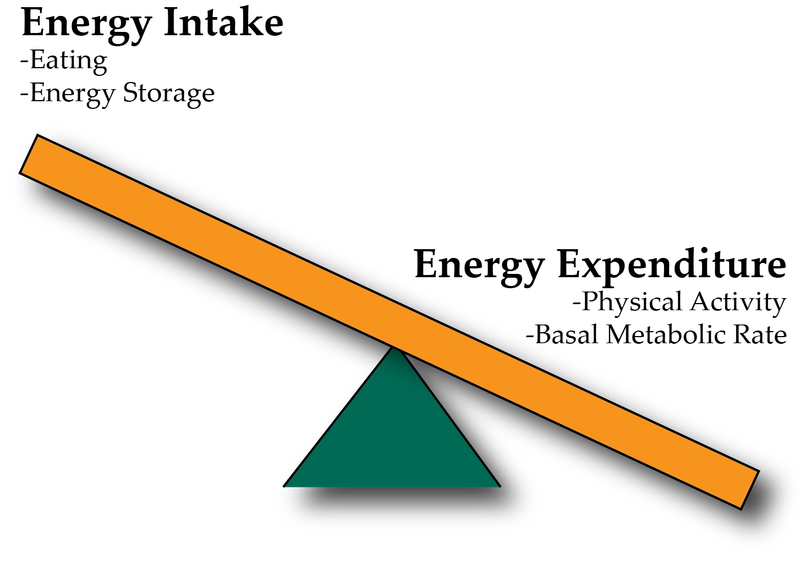
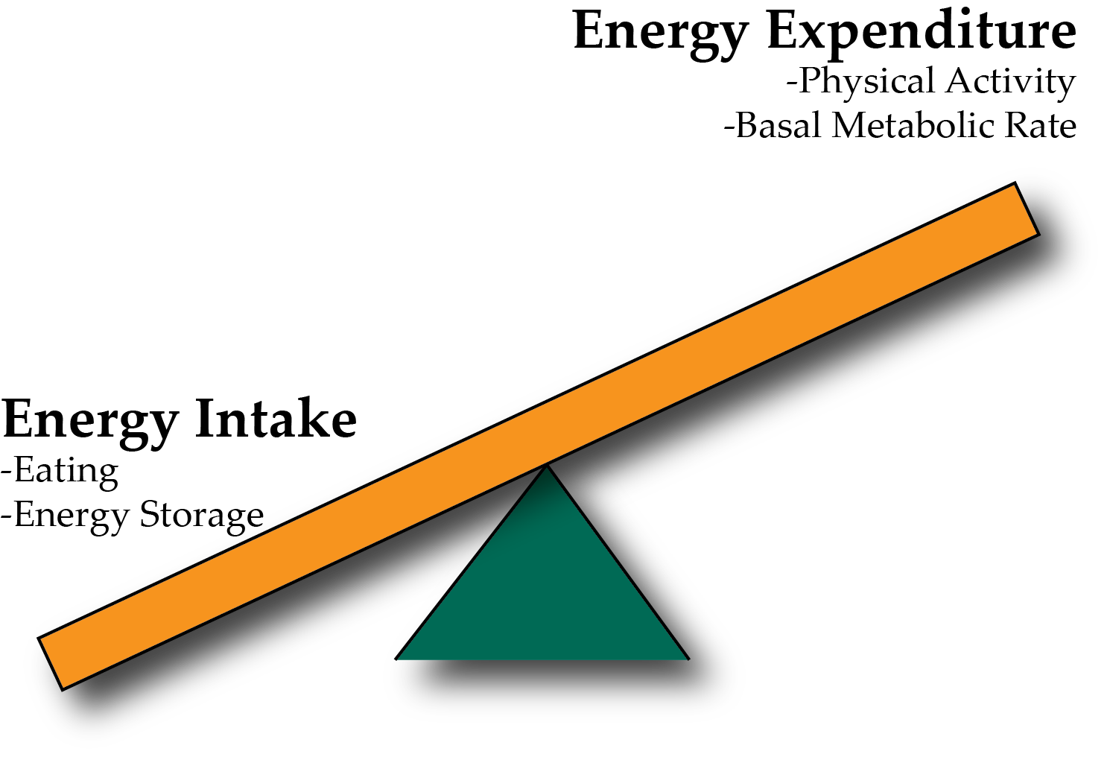
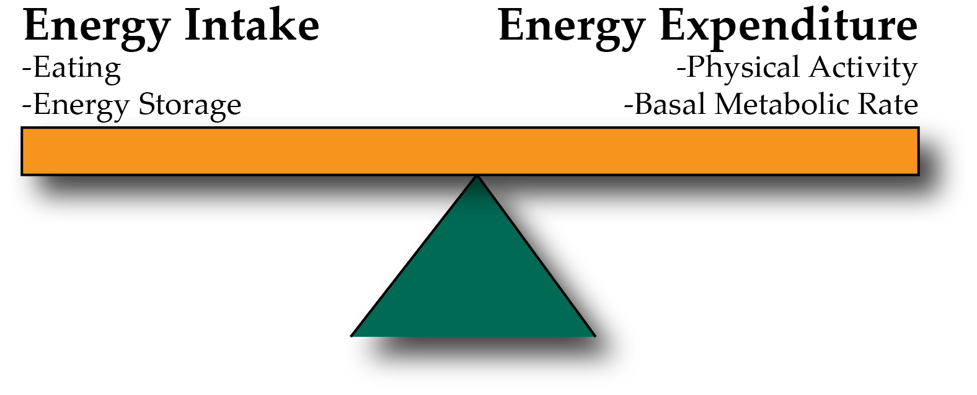
Energy Balance and Obesity
Positive Energy Balance – Weight Gain
Negative Energy Balance – Weight Loss
Notes:
Be here at 9:20

Slide 4
Relationship between activity and intake
Over a Day
Over the Week
Edholm OG. Energy balance in man studies carried out by the Division of Human Physiology, National Institute for Medical Research. J Hum Nutr. 1977; 31: 413–31.

Slide 5
Energy Expenditure, Heat and Oxygen Consumption
Energy cannot be created or destroyed but can be interconverted
Nutrients -> ATP -> Muscle Contraction
At each step some energy is lost as heat
Therefore fundamentally, energy expenditure is measured by heat generation, also known as Thermogenesis

Slide 6
What is heat and why is it relevant for energy expenditure?
Thermogenesis is the generation of heat from metabolic processes.
Metabolic efficiency is the percent of energy intake that is stored
Metabolic inefficiency is the percent of energy intake that is released (either as heat, or excreted)
Most of energy captured as ATP/NADH/FADH₂ but for each reaction a small amount is released as heat

Slide 7
Parts of the Metabolic Rate Metabolic Rate
Energy Expenditure Component | Increased by
Exercise Activity Thermogenesis (NEAT/EAT) | Exercise and movement
Thermic Effect of Food (TEF) | Protein in Meal, Insulin Sensitivity, Meal Size
Basal Metabolic Rate | Young Age, Sex (M), Lean Mass, Set Point
Maclean PS, Bergouignan A, Cornier M-A, Jackman MR. Biology’s response to dieting: the impetus for weight regain. Am. J. Physiol. Regul. Integr. Comp. Physiol. 2011;301(3):R581–R600. http://dx.doi.org/10.1152/ajpregu.00755.2010
Notes:
Impact of weight loss on the components of total energy expenditure (TEE). Energy-restricted weight loss impacts every component of energy expenditure. The absolute levels of resting energy expenditure (REE) decline from a loss of metabolic mass and enhanced metabolic efficiency. Nonresting energy expenditure (NREE) declines, unless the level of physical activity and its associated exercise activity thermogenesis (EAT) are substantially increased. This increase must overcome the decline in the TEF that results from lower energy consumption and a decline in nonexercise activity thermogenesis (NEAT) related to loss in overall mass. Increased energetic efficiency of EAT, NEAT, and potentially TEF contribute to the overall decline in NREE.

Slide 8
An organ-centered view of metabolism
Notes:
We know the sleeping metabolic rate is about 5 percent less than resting metabolic rate when you’re awake

Slide 9
Diet Induced Thermogenesis
Increased with bigger meals, insulin sensitivity and the amount of protein in a meal

Slide 10
Parts of the Metabolic Rate Metabolic Rate
Energy Expenditure Component | Increased by
Exercise Activity Thermogenesis (NEAT/EAT) | Exercise and movement
Thermic Effect of Food (TEF) | Protein in Meal, Insulin Sensitivity, Meal Size
Basal Metabolic Rate | Young Age, Sex (M), Lean Mass, Set Point
Maclean PS, Bergouignan A, Cornier M-A, Jackman MR. Biology’s response to dieting: the impetus for weight regain. Am. J. Physiol. Regul. Integr. Comp. Physiol. 2011;301(3):R581–R600. http://dx.doi.org/10.1152/ajpregu.00755.2010
Notes:
Impact of weight loss on the components of total energy expenditure (TEE). Energy-restricted weight loss impacts every component of energy expenditure. The absolute levels of resting energy expenditure (REE) decline from a loss of metabolic mass and enhanced metabolic efficiency. Nonresting energy expenditure (NREE) declines, unless the level of physical activity and its associated exercise activity thermogenesis (EAT) are substantially increased. This increase must overcome the decline in the TEF that results from lower energy consumption and a decline in nonexercise activity thermogenesis (NEAT) related to loss in overall mass. Increased energetic efficiency of EAT, NEAT, and potentially TEF contribute to the overall decline in NREE.

Slide 11
How do we measure metabolic rates?
Doubly Labelled Water

Slide 12
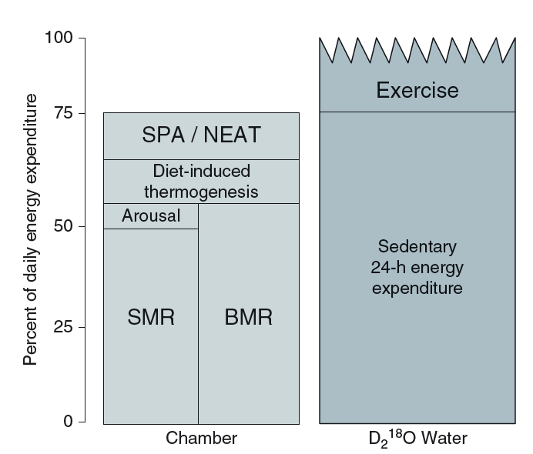
Think, Pair, Share: Strengths and Limitations of Indirect Calorimetry vs Doubly Labelled Water
Jot down some notes for yourself
Talk to someone near you
Bring it back to the group
Notes:
Be here at 9:30

Slide 13
Major Determinants of Energy Expenditure
Amount of metabolically active tissue (fat-free mass)
How inefficient that tissue is
In terms of weight loss, inefficiency is good
Strong relationship between REE and Fat-Free Mass
Modified by
Age (declines with age)
Sex (~11% higher in males)
Genetics (V_{g} ~ 11%)
Illner K, Brinkmann G, Heller M, Bosy-Westphal A, Muller MJ. Metabolically active components of fat free mass and resting energy expenditure in nonobese adults. Am J Physiol Endocrinol Metab. 2000; 278: E308-15.
Notes:
The major factors that contribute to the BMR are age (declines with age), sex (approximately 11 % higher in males) and body mass, particularly fat-free (or lean) mass. Up to 85 % of the variance in BMR can be explained by these factors,

Slide 14
Hereditability of Basal Metabolic Rate
Total heritability is about 40%
From Twin Studies Genetics (V_{g}) ~ 11% of the variance after accounting for similarities in fat free mass.
Bogardus, C. et al. Familial Dependence of the Resting Metabolic Rate. N. Engl. J. Med. 315, 96–100 (1986).

Slide 15
Estimating Total Daily Energy Expenditure
Miflin/St. Jeor Equations
REE = 22.5 x FFM + 209 (M)
REE = 20.8 x FFM + 360 (F)
Without knowing Body Fat Percent
10 x weight (kg) + 6.25 x height (cm) – 5 x Age + 5 (M)
10 x weight (kg) + 6.25 x height (cm) – 5 x Age – 161 (F)
Example:
[52 kg x 10] + [167 cm x 6.25] – [39y x 5] + 5 = 1363 Calories/day
Active Energy = 336 Cal/day
TEF (est 10 % of food intake) = 200 Cal/day
Total Energy Expenditure = 1899 Cal/day
M
F
Mifflin, M. D. et al. A new predictive equation for resting energy expenditure in healthy individuals. Am. J. Clin. Nutr. 51, 241–7 (1990).
Notes:
I am 155 lbs, 80% fat free mass and male so 520 + 1043 - 195
The major factors that contribute to the BMR are age (declines with age), sex (approximately 11 % higher in males) and body mass, particularly fat-free (or lean) mass. Up to 85 % of the variance in BMR can be explained by these factors,
1043

Slide 16
Homework before next class
Dietary Assessments
Several tools used, including 24h recalls, food frequency questionaires or food photography
Choose one of those tools and complete an assessment on yourself, a friend or a family member
Will discuss your experience with these tools on Thursday
Details on Canvas

Slide 17
Trends in Physical Activity

Slide 18
Trends in Workplace Physical Activity
Church TS, Thomas DM, Tudor-Locke C, Katzmarzyk PT, Earnest CP, Rodarte RQ, Martin CK, Blair SN, Bouchard C. Trends over 5 decades in U.S. occupation-related physical activity and their associations with obesity. PLoS One. 2011; 6: 1–7. doi: 10.1371/journal.pone.0019657.

Slide 19
Leisure Time Physical Activity
National Health Interview Survey, 2016

Slide 20
Effectiveness of Physical Activity in Weight Loss
https://www.youtube.com/watch?v=eXTiiz99p9o
Notes:
Play video if here at 9:45

Slide 21
How do you think over-eating alters the basal metabolic rate?
I think metabolic rate would be lower after over-eating
I think metabolic rate would be higher after over-eating
What do you think fasting or caloric restriction would do to the metabolic rate?
Notes:
Be here at 9:50

Slide 22
Over/underfeeding and metabolic rates
Leibel RL, Rosenbaum M, Hirsch J. Changes in energy expenditure resulting from altered body weight. N. Engl. J. Med. 1995;332(10):621–8. http://dx.doi.org/10.1056/NEJM199503093321001

Slide 23
The Biggest Loser Follow-Up Study
Fothergill E, Guo J, Howard L, Kerns JC, Knuth ND, Brychta R, Chen KY, Skarulis MC, Walter M, Walter PJ, Hall KD. Persistent metabolic adaptation 6 years after “The Biggest Loser” competition. Obesity. 2016; 24: 1612–9. doi: 10.1002/oby.21538.
Notes:
Those with sustained weight loss, did so even in spite of a more pronounced reduction in RMR after 6 years

Slide 24
Consider in pairs the repercussions of this metabolic adaptation for weight loss
How does this relate to what we talked about last week regarding appetite after weight loss

Slide 25
Benefits of Physical Exercise
Flexibility
Strength
Mood
Cardiovascular health
Benefits at all BMI categories
Blair SN, Kohl HW, Paffenbarger RS, Clark DG, Cooper KH, Gibbons LW. Physical fitness and all-cause mortality. A prospective study of healthy men and women. JAMA. 1989; 262: 2395–401. doi: 10.1001/jama.1989.03430170057028.

Slide 26
Physical Activity Independently Reduces Mortality Risk
Lear, S. A. et al. The effect of physical activity on mortality and cardiovascular disease in 130 000 people from 17 high-income, middle-income, and low-income countries: the PURE study. Lancet 6736, 1–12 (2017).

Slide 27
Back to the Biggest Loser Cohort
Kerns, J. C. et al. Increased Physical Activity Associated with Less Weight Regain Six Years After “The Biggest Loser” Competition. Obesity 25, 1838–1843 (2017).

Slide 28
Why are activity levels the most predictive of sustained weight loss post diet?

Slide 29
Learning Objectives
Describe what is meant by energy expenditure and how it relates to energy balance
Distinguish between methods to evaluate energy expenditure, including advantages and disadvantages of each (step counts, doubly-labelled water, indirect calorimetry)
Define the components of total daily energy expenditure
Assess how each component is affected by diet, genetics, sex, age and activity levels
Explain the relationship between energy expenditure and obesity
Understand the associations between physical activity and risk of obesity
Assess how total daily energy expenditure changes during weight gain or loss and how this relates to weight loss efficacy
Summarize the health benefits of exercise, independent of changes in energy expenditure

